Slide 1
Contribute with GitLab
SA² team (Software Automation Architecture)
February 2019

Slide 2
Introduction
Concepts
Existing workflows
Our workflow
Training
00’10
00’30
00’30
00’20
01’30

Slide 3
Contribute with GitLab
Introduction

Slide 4

Introduction
Contribute with GitLab
Git
GitLab
A contribution workflow
Notes:
Git --> presented in previous presentation

Slide 5
Introduction
GitLab
Hosts Git repositories
Adds collaborative & CI features
Very similar to GitHub
Open source

Slide 6
Introduction
GitLab
GitLab.com (free)
Community Edition (free)
Enterprise Edition (paying)
Notes:
EE = CE + additional features (list of MR approvers by project, advanced admin control, advanced support)

Slide 7
Introduction
Contribution workflow
Set of common rules and good practices
Define one that everyone agree with
Identify problems and questions before merging
Notes:
Several possible workflows with Git/GitLab

Slide 8
Contribute with GitLab
Concepts

Slide 9
Project
Concepts

Slide 10

Project
Git repository + collaborative data
Private, internal or public
Owned by a group or a user

Slide 11
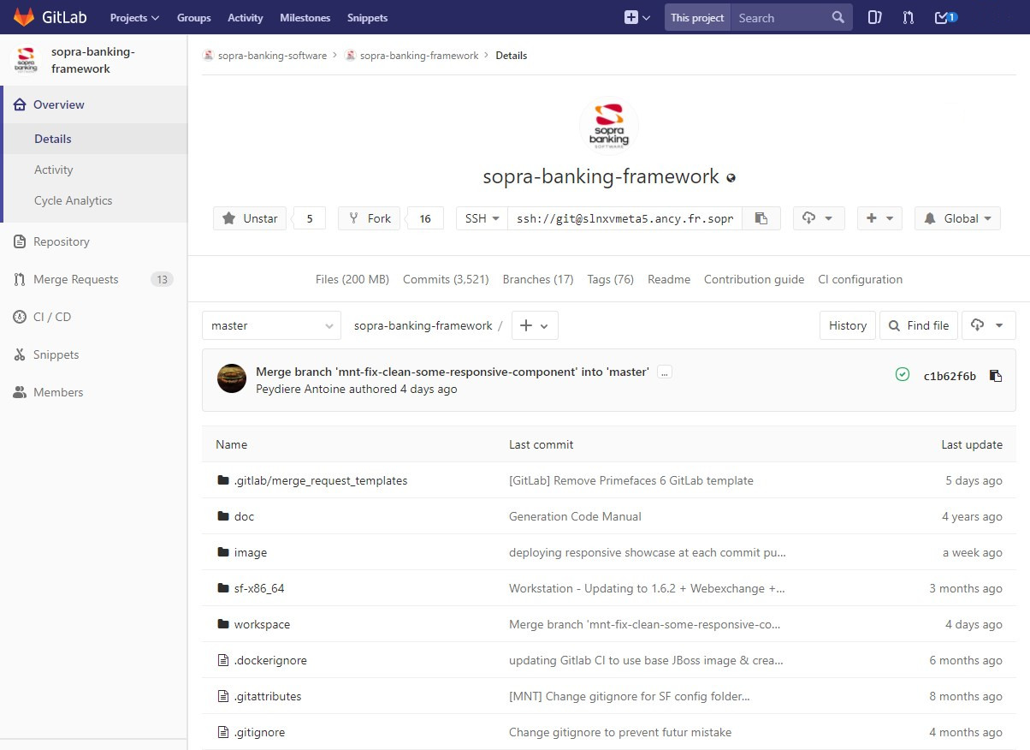
Project
Files explorer
Example:
https://innersource.soprasteria.com/sopra-banking-technical-architecture/sopra-banking-framework
Notes:
Project files explorer
file search shortcut --> just press ‘t’

Slide 12
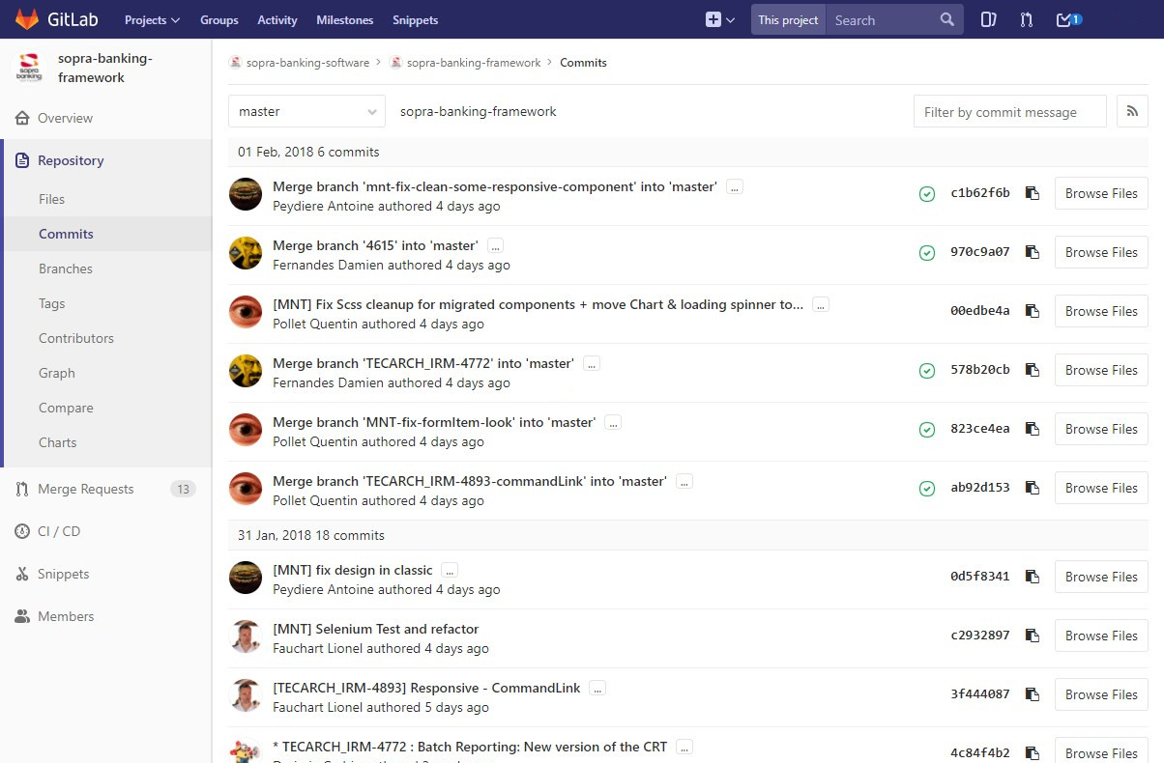
Project
Commits view
Example:
https://innersource.soprasteria.com/sopra-banking-technical-architecture/sopra-banking-framework/commits/master
Notes:
Commits view (by branch)

Slide 13
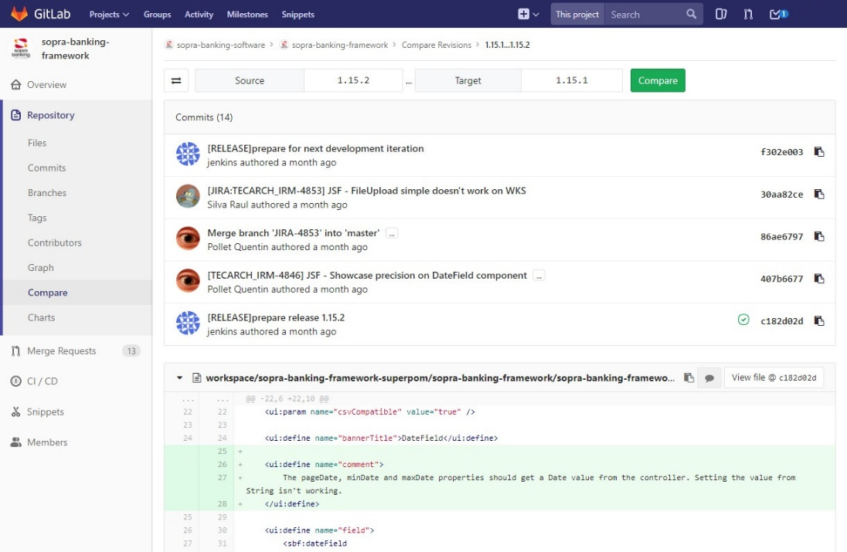
Project
Branches view / compare
Example:
https://innersource.soprasteria.com/sopra-banking-technical-architecture/sopra-banking-framework/compare/1.15.1...1.15.2
Notes:
Compare branches

Slide 14
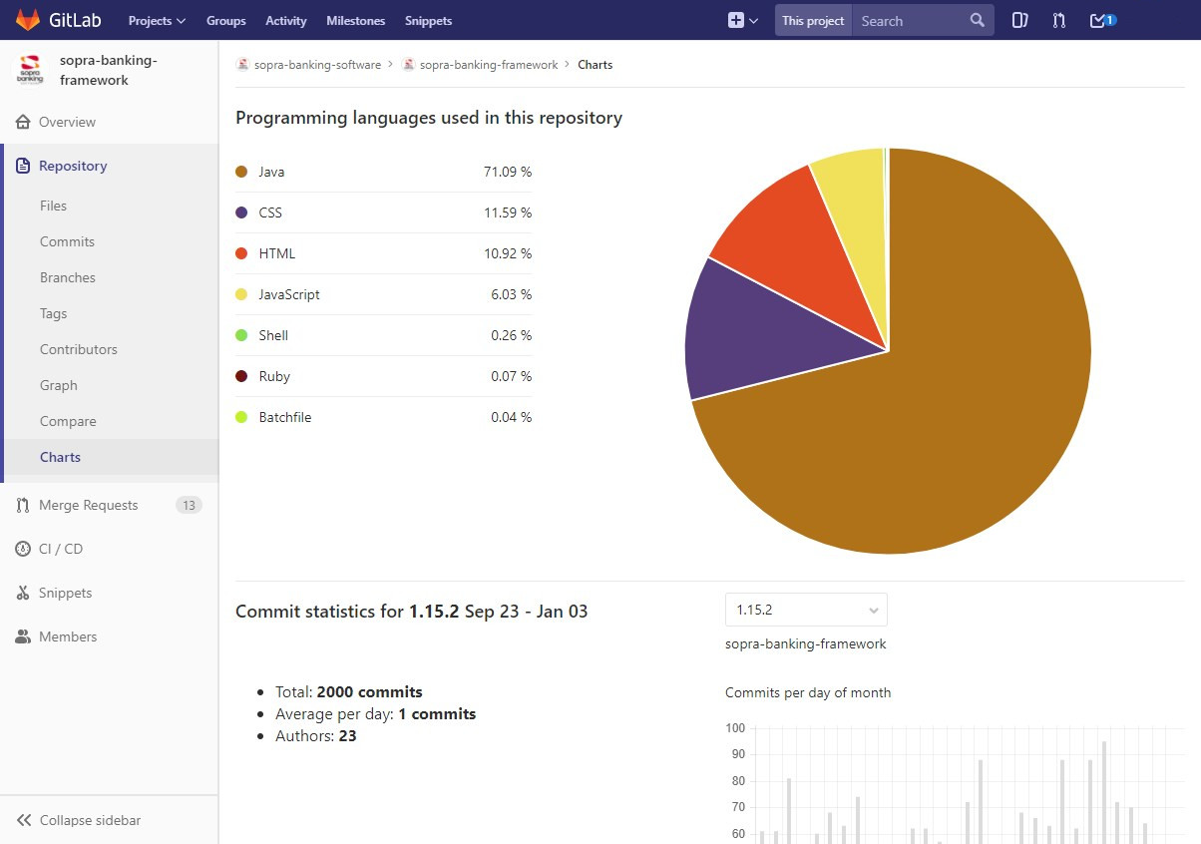
Project
Statistics
Example:
https://innersource.soprasteria.com/sopra-banking-technical-architecture/sopra-banking-framework/graphs/1.15.2/charts
Notes:
Project statistics and diagrams

Slide 15
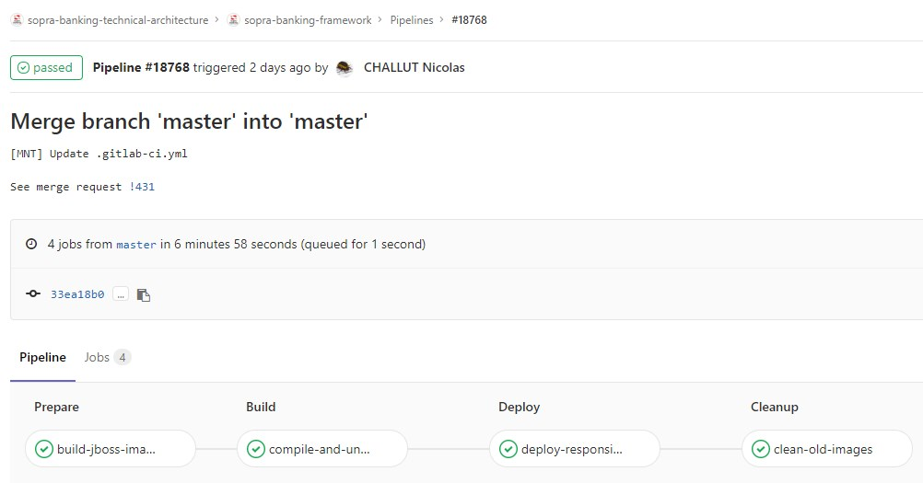
CI configuration
.gitlab-ci.yml
Pipeline of jobs
Triggered by commit push
Status on Merge Request
Project
Example:
https://innersource.soprasteria.com/sopra-banking-technical-architecture/sopra-banking-framework/pipelines/18768
Notes:
.gitlab-ci.yml is in project files
Build status of last commit displayed on Merge Request page

Slide 16
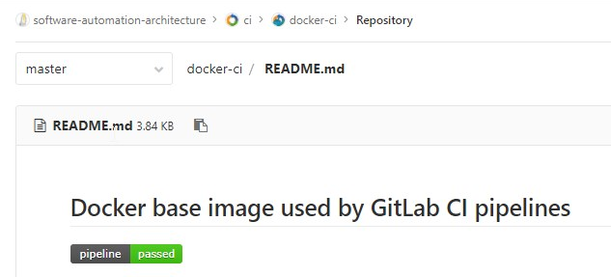
Project
Build status badge in README.md
Example:
https://innersource.soprasteria.com/software-automation-architecture/ci/docker-ci/blob/master/README.md
# Docker base image used by GitLab CI pipelines
[![pipeline status](https://innersource.soprasteria.com/software-automation-architecture/ci/docker-ci/badges/master/pipeline.svg)](https://innersource.soprasteria.com/software-automation-architecture/ci/docker-ci/commits/master)
Notes:
Markdown file
Displayed on project home page

Slide 17
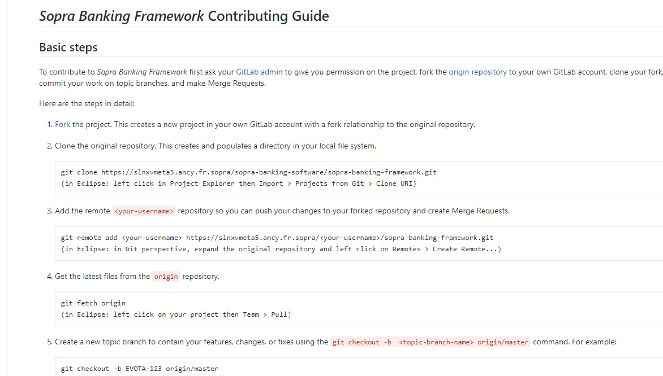
CONTRIBUTING.md
Project
Example:
https://innersource.soprasteria.com/sopra-banking-technical-architecture/sopra-banking-framework/blob/master/CONTRIBUTING.md
Notes:
Contribution guide
Contribution guidelines & rules
Link on project home page

Slide 18
Contribute
Concepts

Slide 19
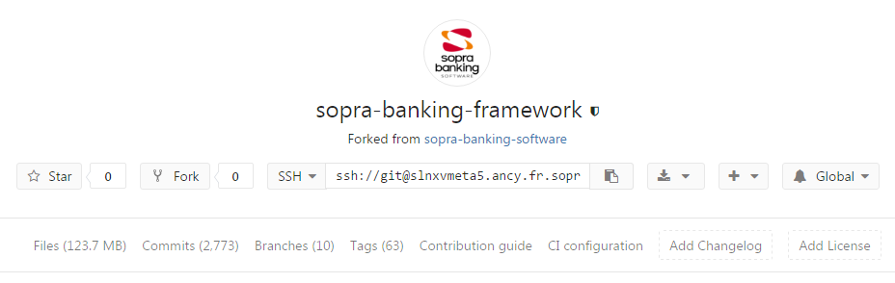
Contribute
Fork
Copy of an existing repository
New project on another group/user workspace
Link to origin project
Notes:
In GitLab information about the fork nature is saved in project metadata
User can do anything on his fork
(as long as changes are not pushed to origin repository)
No reason to « pollute » origin repository with a lot of branches

Slide 20
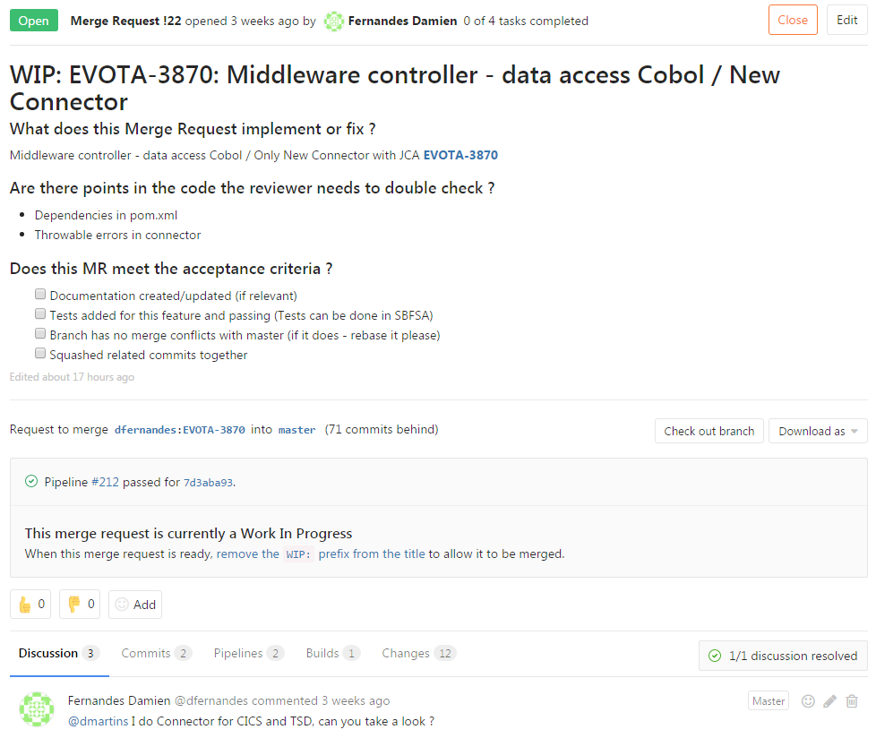
Contribute
Merge Request
Notes:
MR is a GitLab term (GitHub has Pull Request)

Slide 21
Contribute
Merge Request
Request to integrate changes in main repository/branch
Related to a (JIRA) Story
From a branch in same project or in a fork
Discussed, reviewed, (reworked,) validated and… merged
Notes:
MR is a GitLab term (GitHub has Pull Request)

Slide 22
Contribute
Merge Request
One Merge Request ≠ one commit
Usual target branch is origin/master
Both human and automated validation
Notes:
Merge Request is from a branch to a branch
--> can contain several commits
+ changes aim to be deployed in production (once all OKs obtained)

Slide 23
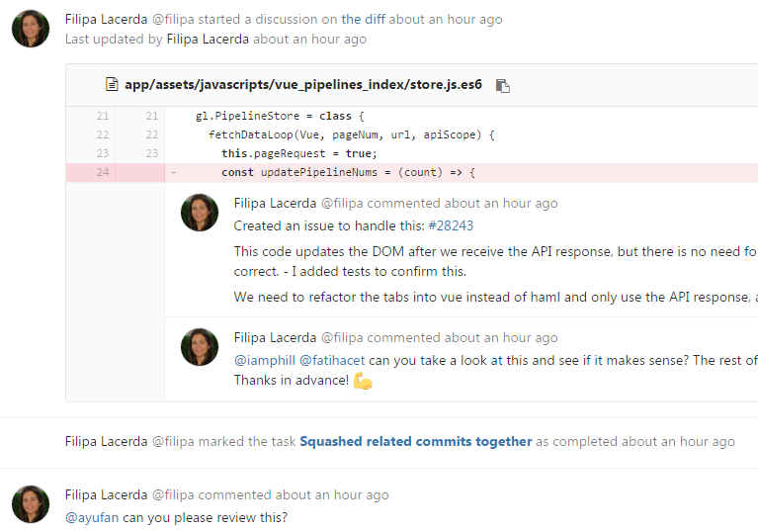
Contribute
Code review
Manual / read code
Validate Merge Request made by another developer
Any relevant discussion, link, quote, inline, …
Notes:
Any relevant question must be asked, not only about bugs and errors in code
Goal = Make sure that changes that will be merged are relevant, understood and correct
Inline + global comments, Markdown, quote users, add links to code, …

Slide 24
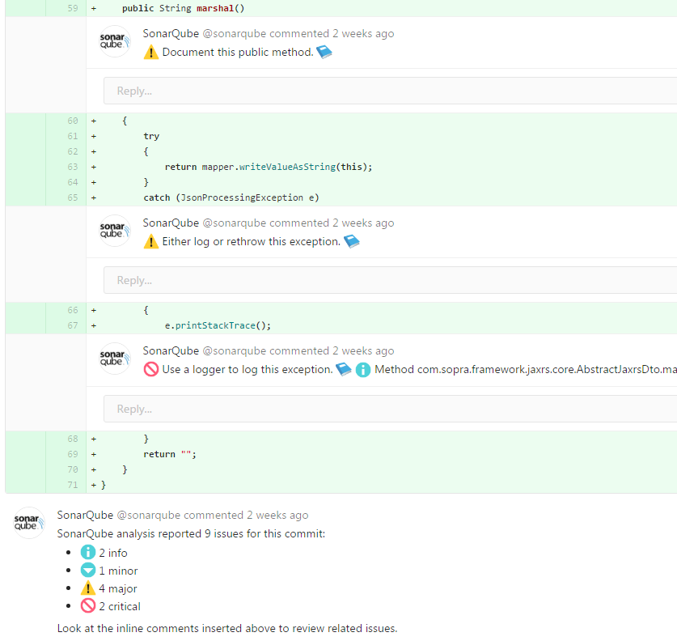
Contribute
Automated validation
Compile & unit tests
Sonar analysis
Fail if error
Notify author
Notes:
Goal = find and repair problems & regressions before merging

Slide 25
Contribute with GitLab
Existing workflows
Notes:
These workflows provide guidelines rather than concrete rules
Mix and match aspects from different workflows to suit your individual needs

Slide 26

Workflows
Centralized flow
Central repository
All changes committed to origin/master
SVN-like
Notes:
+ own local copy of repository
+ push commits when all ready
- work on new features not isolated
- potentially a lot of update to do each day + a lot of conflicts to resolve

Slide 27
Workflows
Feature branch flow
Centralized flow + feature branches
Isolated branch per feature/Story
Work on a particular feature without disturbing the main codebase
Merge Requests possible (code review, discussion)
Feature Branch – (Martin Fowler) https://martinfowler.com/bliki/FeatureBranch.html
Notes:
+ feature dedicated « work space »
+ encourage discussion & communication between developers working on same feature
+ master branch never contains broken code
- may result to a lof of branches on base repository
- no hosted/backup repository per developer

Slide 28
Workflows
Forking flow
No push to central repository
Every developer has a fork of the original repository
So each developer has two Git repositories
Only the project maintainer can push to the original repository
Original repository evolves through merge requests
Notes:
+ no need to give developers write access to the original codebase
+ no need to push to a single central repository
+ “backup” repository per developer (dev makes what he wants on his fork repo)
- one more remote to configure/manage

Slide 29

Workflows
Git flow - http://nvie.com/posts/a-successful-git-branching-model/

Slide 30
Workflows
Git flow - http://nvie.com/posts/a-successful-git-branching-model/

Slide 31
Workflows
Git flow - http://nvie.com/posts/a-successful-git-branching-model/
Feature branch flow + specific roles to different branches
Strict branching model around the project release
branches:
develop = integration branch for features
feature branches = one branch per feature
release branches
master = release history
hotfixes = quick patches for production releases
Notes:
+ define precise interactions & roles
+ very complete
- hard to handle in a GUI
- merging & cherry picking process may take a lot of time
- may be overcomplicated for not smaller projects

Slide 32
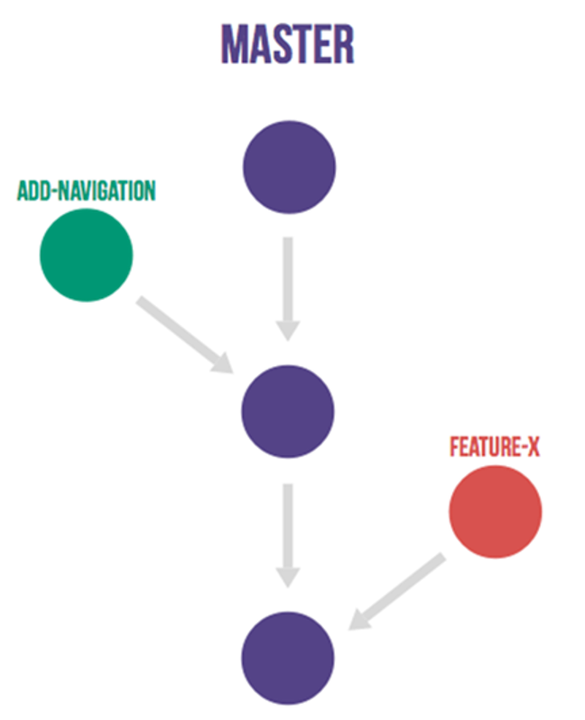
Workflows
GitHub flow - http://scottchacon.com/2011/08/31/github-flow.html
Back to basics
Any commit must be self-sufficient (rollback possible)
Open a Pull Request at any time (ready / need help / need feedback)
Deploy immediately after your Pull Request get reviewed & merged
“Anything in the master branch is always deployable“
Notes:
Feature branch (+ Forking) + simple rules
Each commit is considered a separate unit of change --> rollback must be possible if a bug is found, or if you decide to head in a different direction
--> Make the process as simple as possible in order for anybody to understand it
Do not wait before merging (avoid conflicts with other ongoing changes)

Slide 33
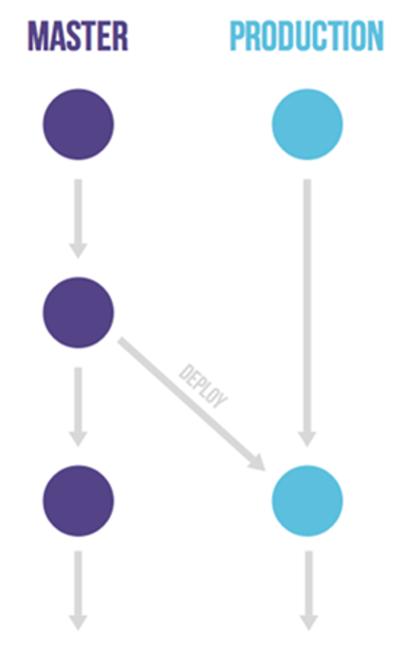
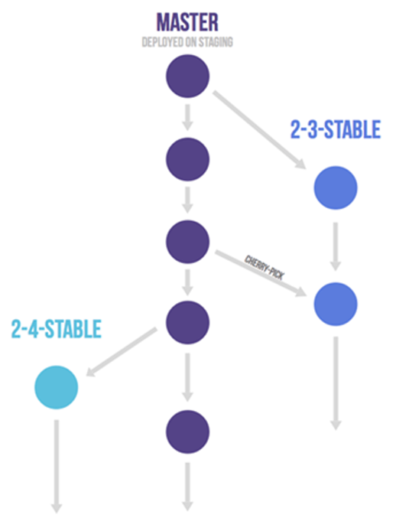
Workflows
GitLab flow - https://docs.gitlab.com/ce/workflow/gitlab_flow.html
Add practical rules to the GitHub flow
protect long-lived branches (usually master)
commit often
test before merging
squash commits with rebase
link issues to Merge Requests
request approvals on Merge Requests
prevent merge commits, but don’t eliminate them
remove merged branch

Slide 34
Contribute with GitLab
Proposed workflow

Slide 35
Proposed workflow
This workflow is explained here https://documentation-sa2.apps.sodigital.io/development-workflow/
origin/master always protected
Feature branch per (JIRA) Story
Merge Request with human & automated validation
Commit & development rules
Notes:
--> if anything seems irrelevant, let’s discuss and agree on a better solution

Slide 36
Proposed workflow
Protected branch (origin/master)
No commits are allowed in origin/master Modify origin/master only through Merge Requests
“Anything in the master branch is always deployable“
Any change must be double checked before merging
Any commit can be rolled back
Protect other branches on origin ?

Slide 37
Proposed workflow
Feature branch per Story
One JIRA Story = one Git branch
Work / discussion / team isolation
Naming convention
Source of Merge Requests
Feature branches can be shared between several devs
Notes:
Avoid very very recurrent conflict resolution when pulling from origin/master
Merge only when changes are ready and validated

Slide 38
Proposed workflow
Merge Request with validation
Create Merge Request once you need:
help
feedback
validation
A Merge Request is a living process
Code review + CI build + Sonar analysis before merging

Slide 39
Proposed workflow
Commit & development rules
Any commit must be « buildable » & « revertable »
Merge Requests description must follow a Template
MRs must be approved before merging (all discussions marked resolved)
Commits in MRs that are related must be squashed before merging

Slide 40
Proposed workflow
GitLab
origin
master branch protected
Summary
remote branch
remote branch
Story_1
Merge Request
Merge Request
Branch per Story (Story-…)
Branches created locally
Common rules in Merge Request template
Merge Request OK when:
Rules OK
Build OK
Sonar OK
2 approvals
Story_2
push
push
local branch
pull --rebase
pull --rebase
local branch
Story_1
Story_2
Dev1
Dev2
Notes:
You have two repositories: one local and one on GitLab
You create one local branch per Story and push it to origin/Story_...
You pull updates from origin/master and push to origin/Story_...
Only way to contribute to origin/master is via Merge Requests
At least 2 other devs must approve (give OK) each MR
A MR cannot be merged if it does not respect rules | didn’t get approvals | does not build | contains Sonar critical or blocker issue

Slide 41
Proposed workflow
GitLab
origin
master branch protected
remote branch
remote branch
Story_1
Merge Request
Merge Request
Story_2
Feature branches can be shared between several developers
push
push
push
push
local branch
pull --rebase
pull --rebase
local branch
Story_1
local branch
local branch
Story_2
Story_1
Story_2
Dev1
Dev2

Slide 42
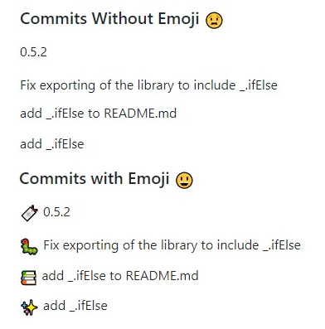
(optional) Commit message Emoji
Swagg up your commit messages
Prepend every commit message with an emoji with this form: <emoji> commit message
https://gitlab.com/gitlab-org/gitlab-ce/blob/master/doc/user/markdown.md#emoji
https://github.com/dannyfritz/commit-message-emoji

Slide 43
Contribute with GitLab
Training

Slide 44

Training
Contribute
Clone origin repository
Create a local branch
Implement changes
Push changes remotely
Check branch on the repos
Create a Merge Request
Assignee: review the Merge Request
Assignee: merge the Merge Request
Update (JIRA) Story status

Slide 45
Training
Clone origin repository
Clone https://innersource.soprasteria.com/software-automation-architecture/git-training from Innersource
Notes:
--> Use Git presentation & training to remember commands

Slide 46
Training
Clone origin repository
Clone https://innersource.soprasteria.com/software-automation-architecture/git-training from Innersource
$ git clone git@innersource.soprasteria.com:software-automation-architecture/training/git-training.git
Notes:
--> Use Git presentation & training to remember commands

Slide 47
Training
Implement changes required by a Story
Go to your JIRA Story & click on « Start »
Create a local branch named following naming convention of your project
Implement & commit changes

Slide 48

Training
Implement changes required by a Story
Go to your JIRA Story & click on « Start »
Create a local branch named following naming convention of your project
$ git checkout –b SA2_BLM-… master
Implement & commit changes
$ git add … & git commit –m "message"

Slide 49
Training
Push changes remotely
Push your local branch remotely

Slide 50
Training
Push changes remotely
Push your local branch remotely
$ git push origin <branch>

Slide 51
Training
Check branch on the repos
Check branch commits on GitLab
Compare your branch with master branch on GitLab
Check that CI build is successful

Slide 52
Training
Check branch on the repos
Check branch commits on GitLab
https://innersource.soprasteria.com/software-automation-architecture/git-training/commits/{branch}
Compare your branch with master branch on GitLab
https://innersource.soprasteria.com/software-automation-architecture/git-training/compare/master...{branch}
Check that CI build is successful
https://innersource.soprasteria.com/software-automation-architecture/git-training/pipelines/{pipeline-id}

Slide 53
Training
Create a Merge Request (1)
In the git-training project create a Merge Request

Slide 54
Training
Create a Merge Request (1)
In the git-training project create a Merge Request
https://innersource.soprasteria.com/software-automation-architecture/git-training/tree /{branch}

Slide 55
Training
Create a Merge Request (2)
Fill Title and Description
Choose another attendee as Assignee
Create Merge Request
Notes:
For the purpose of the training each attendee must both:
- Create a Merge Request & assign someone else
- Get assigned on a Merge Request

Slide 56
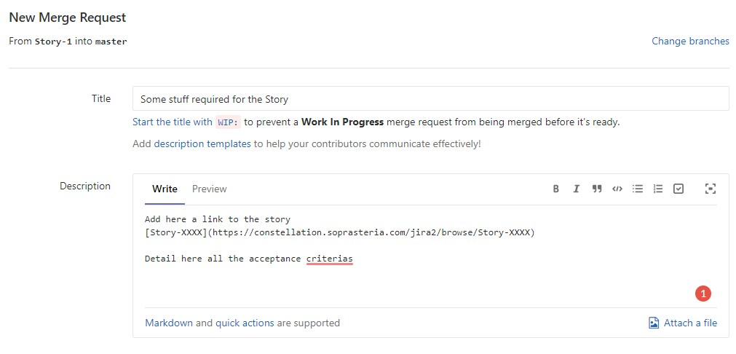
Training
Create a Merge Request (2)
Fill Title and Description

Slide 57
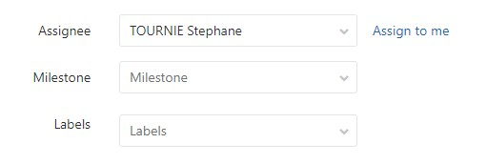
Training
Create a Merge Request (2)
Choose another attendee as Assignee

Slide 58
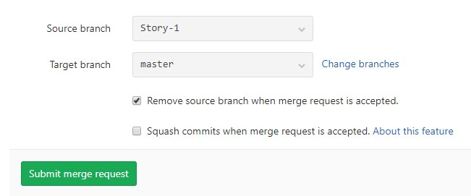
Training
Create a Merge Request (2)
Create Merge Request
Important

Slide 59
Training
Create a Merge Request (3)
Comment on your JIRA Story with a link to the Merge Request...
or setup JIRA integration on your Innersource project
→ reference and close JIRA items from Merge Requests

Slide 60
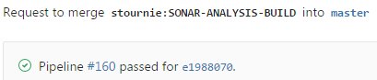
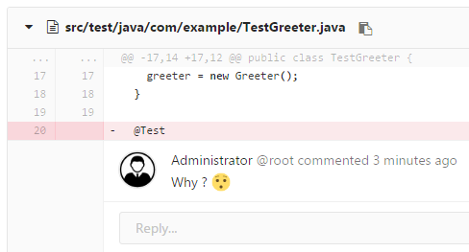
Training
Assignee: review Merge Request (1)
Check build status on Merge Request
Check particular points to review
Read/review changes
Open inline / global discussion(s)
Wait for answer from the developer
Notes:
--> show on real Pull Request

Slide 61
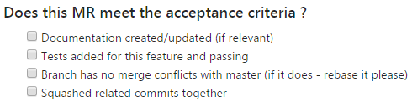
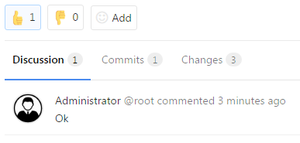
Training
Assignee: review Merge Request (2)
Check that all discussions are well answered
Check that all new changes are ok
Check that all « acceptance criteria » are ok
Give your approval
Notes:
Cannot merge if all discussions are not resolved
--> show on real Pull Request

Slide 62
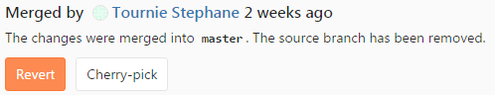

Training
Assignee: merge Merge Request
Click on Merge button
Wait for merge process to finish
Check commits on origin/master

Slide 63
Training
Update status of JIRA Story
Set status to « Done » on JIRA Story...
or do nothing thanks to JIRA integration

